Slide 1
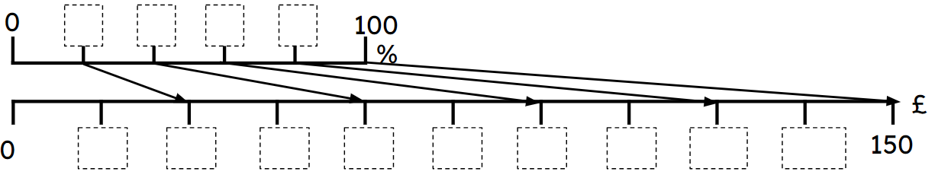
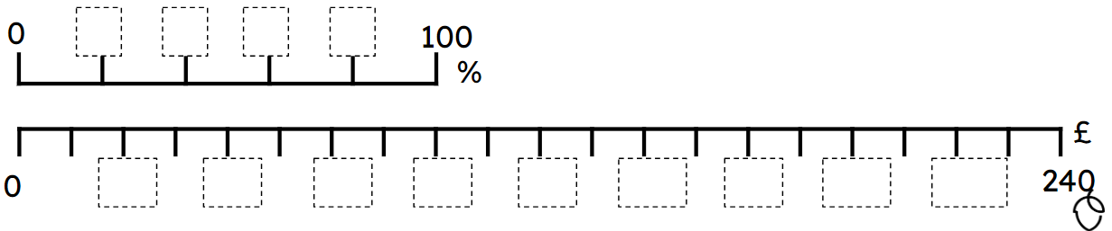
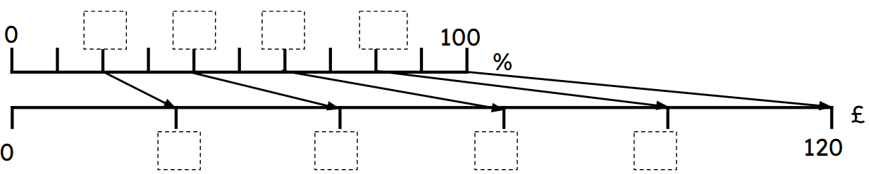
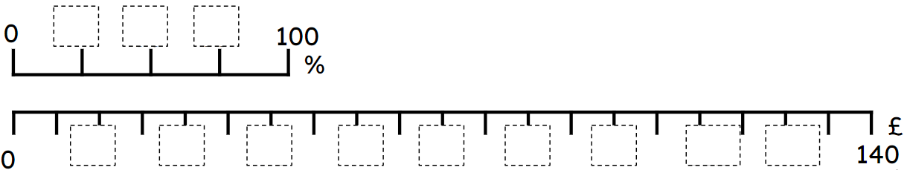
Scaling diagrams for multiplicative relationships
Task A: Scaling diagrams
Fill in the missing information (including arrows) using the scaling diagrams.
a)
Show 60% of 150 = 90
b)
Show 40% of 240 = 96
240
2) Fill in the missing information (including arrows) using the scaling diagrams.
a)
Show 60% of 120 = 72
b)
Show 75% of 140 = 105

Slide 2
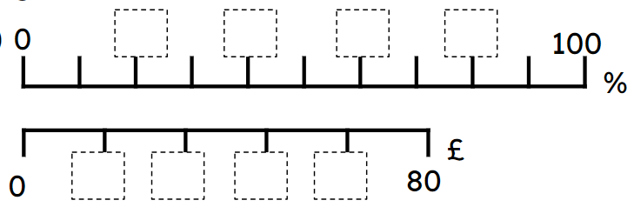
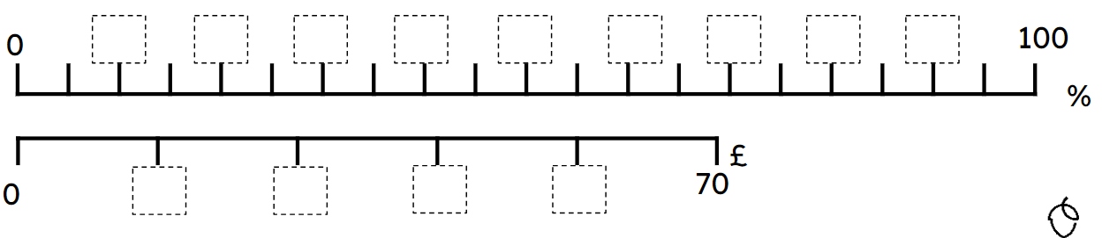
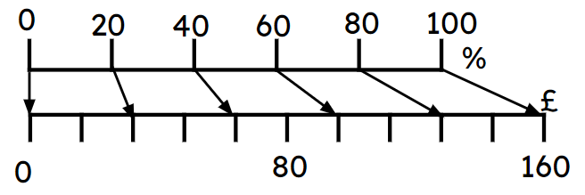
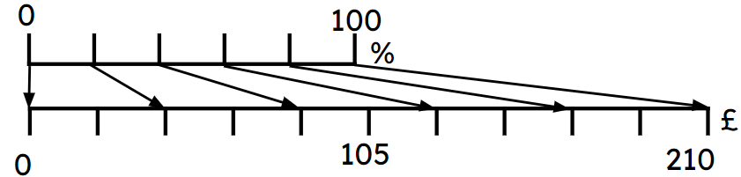
Scaling diagrams for multiplicative relationships
3) Fill in the missing information (including arrows) using the scaling diagrams.
a)
Show 60% of 80 = 48
Show 40% of 70 = 28
b)
Task B: Comparing representations
1) Fill in the missing information on the ratio table and the scaling diagram.
Amount | %
 | 100
 | 40
 | 15
×……
×……
Amount | %
 | 100
 | 60
 | 24
×……
×……

Slide 3
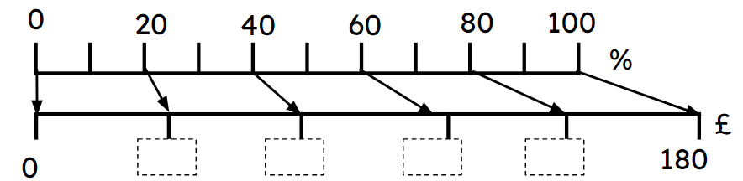
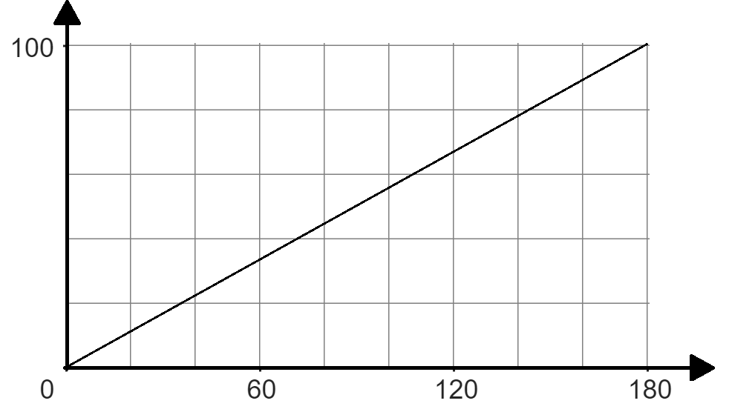
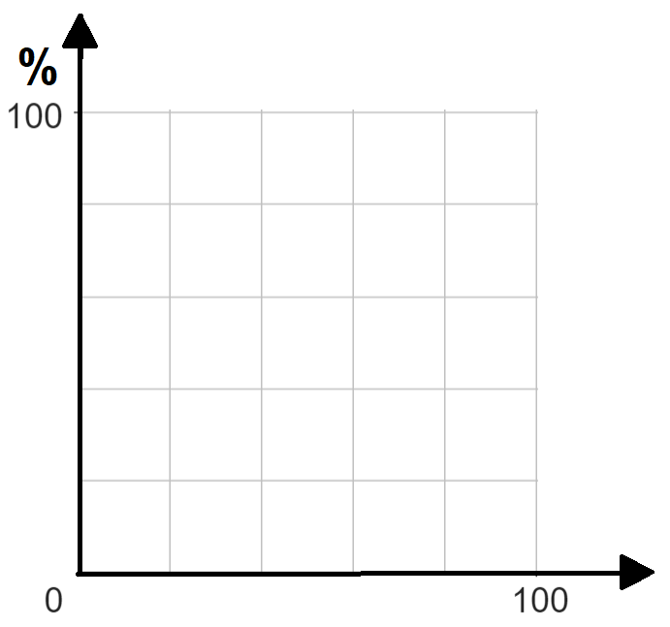
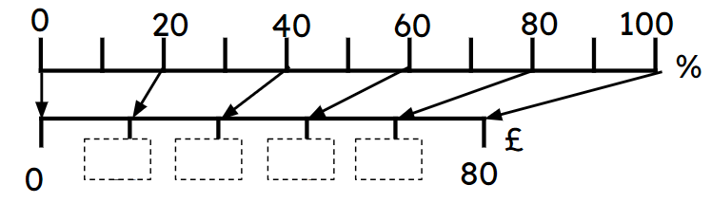
Scaling diagrams for multiplicative relationships
2a) Fill in the missing information, using the different representations.
Amount | %
 | 100
 | 40
 | 15
×……
%
40
100
%
72
180
£
£
2b) Fill in the missing information, using the different representations.
Amount | %
 | 100
 | 50
32
0.4
£
50
%
80
£
× …..
Mathematics in Education and Industry.
v2.3

